Slide 1


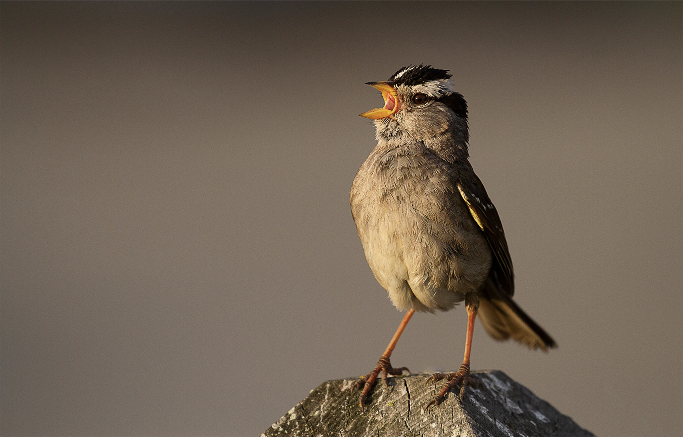
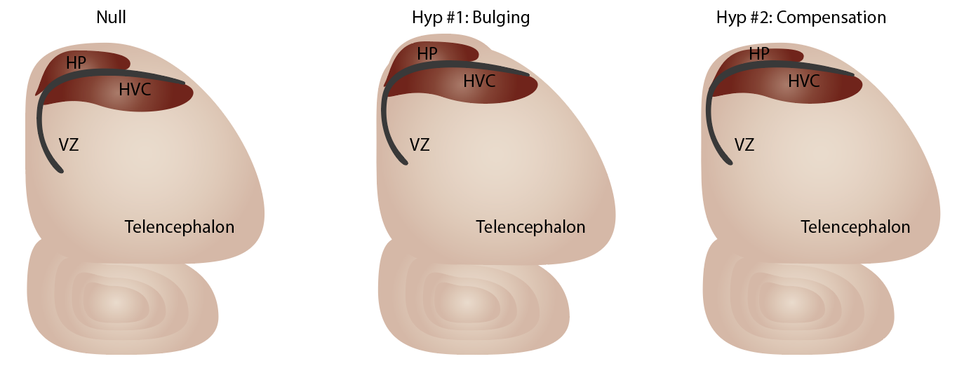
Title Line 1
Title Line 2
First MI Last Name^{1,2}, Additional Authors^{1,2}, PI First MI Last²
¹Department of [Major Department/Program], ²Department of [Home of PI], University of Virginia
Lab or program logo – delete this text!
Poster ID ##
Background
Paragraph on system basics
Paragraph on specifics for project including hypothesis or aims
Insert schematic with basic background of system, image of research subject, graphic of hypothesis. Examples below – no need for figure legends, here or anywhere on poster. If need to clarify images/figures consider re-design of the figure or headers
Brief Summary of Major Finding #1
Brief description of hypothesis and overall methods – one sentence
“To uncover such and such, we performed…”
Brief statement of results – one sentence
Then insert figure.
Brief Summary of Major Finding #3 or Future Directions
If Future Directions, move below Conclusions
For future directions, best is to use a combination of brief hypothesis/goal and methods in text with a schematic to represent the experiment of interpretation of experiment.
For poster background, white is best and least distracting
If you want a colored background, keep minimal don’t allow to distract from the actual content of your poster
Images as background rarely look good – usually they are not high enough resolution for the size of the poster when printing
Conclusions
Conclusions major findings (like bullet points without bullets)
[Ideally insert summary schematic for explaining to people who learn best visually]
Brief Summary of Major Finding #2
Brief description of hypothesis and overall methods – one sentence
“To uncover such and such, we performed…”
Brief statement of results – one sentence
Then insert figure.
As a final step, make sure the boxes containing each section are evenly spaced and aligned properly
Some creative spacing might be required within each box to accommodate proper spacing between boxes – don’t just add text to fill in space!
Methods
Paragraph on basic overall methods with schematics to represent time-line and/or methods
Try to use standardized colors in background, methods, and results so allow visitors to easily visualize experimental groups
Acknowledgements
We thank … for their assistance with… . Supported by [insert any scholarships or grants for research here] to [initials] – include all authors. [Insert citations here if necessary]

